Slide 1

Ololade Folashade
Improving Resource Allocation & Sustainable Funding for Health Department Programs – What the data says?
- SLCO Business Analyst, Health Department
March 5th 2025

Slide 2
Agenda
Problem Statement
Objective
Methodology and Structure of Analysis
Insights & Visualizations
Recommendations & Decision Support Model
Risks and Considerations
Technical Overview
Conclusion
Next Steps
Questions

Slide 3
Problem Statement
The Salt Lake County Health Department exists to promote and protect community and environmental health using various health programs. However, they’ve recently encountered a challenge. This challenge can be broken down into two sections:
Maintaining the sustainability of long-term funding for core health programs
Maximizing funding resources to meet Health Department operations and community needs
Notes:
Many health programs rely on grants, government budgets, and other funding sources that may not be stable or sufficient over time. Leadership needs data-driven insights to assess which programs are financially sustainable and which require additional funding, restructuring, or alternative financing strategies.

Slide 4
Objective
The goal of this project is to build a data-driven decision-support framework for Salt Lake County Health department that will:
Evaluate the sustainability of health programs in the long term
Understand community needs
Predict health programs utilization
To optimize funding (grants etc.) and tax revenues allocation for each programs and the core functions of the health department.
Notes:
This problem is critical for the health department to ensure community needs are met by optimizing resource allocation and understanding current and future community health needs. To do so they need an integrated data platform that collects data from each program and provides real time insights leveraging data driven decision support models that relies on deep quantitative research and artificial intelligence techniques.

Slide 5
Methodology and structure of Analysis
Process Mapping
Data Collection
Inference
Real time analysis dashbaords
Define Success
Data Cleaning
Exploratory Data Analysis
Builde Model
Optimize model
Notes:
I made an assumption to collect data from 3 different departments. The different data

Slide 6
Methodology and structure of Analysis
Methodology
Framework | Why
Weighted Average | Used to determine impact multiplier. Considers customer average service rank, % of health dept budget, customer +ve comment, internal program rank/impact
Impact Multiplier | Used to determine impact score. It is a number between 0 and 1 and is based on the factors mentioned above and is used to calculate utilization rate.
Utilization Rate | Impact multiplier * No of people served
K-means Clustering | An unsupervised machine learning algorithm that helps explore the data
ARIMA | Machine learning forecasting technique to forecast site visit, community needs
Multivariate Linear Regression | A supervised machine learning algorithm that identifies relationship between variables and predicts outcomes based on service metrics.
Notes:
I made an assumption to collect data from 3 different departments. The different data

Slide 7
Methodology and structure of Analysis
Program Data
Chemical Contamination property
Housing problem
STD Testing
Food handler card
Food safety management
Housing Program
STD Clinic Program
Food Protection Program

Slide 8
Methodology and structure of Analysis
Housing Program Data – Sample Data Collection for Housing Reporting and Housing Problem
Housing Program
STD Clinic Program
Food Protection Program
 | Site Visits | Requests | Month | Year | Mortgages
0 | 115466 | 11184 | 2 | 2018 | 12947
1 | 111195 | 8748 | 8 | 2014 | 12034
2 | 104640 | 11013 | 9 | 2019 | 17823
3 | 96427 | 8522 | 9 | 2008 | 19891
4 | 100969 | 12376 | 5 | 2014 | 11747

Slide 9
Methodology and structure of Analysis
Data Dictionary – Framework Data
Programs
Column Name | Description
Program ID | Unique identifier for each health department program.
Program Name | Name of program (e.g. Housing Assistance, STD Clinic).
Budget
Column Name | Description
Program ID | Unique identifier for each health department program.
Program Year | Years program active and received funding.
Program Amount | Funding amount allocated to to program/year
Funding
Column Name | Description
Program ID | Unique identifier for each health department program
Funding Source | Name of organization or entity providing funds (e.g., Local Taxes, Government Grants).
Funding Amount | Total amount of money provided by funding source.
Funding Year | Year funds allocated and received.

Slide 10
Methodology and structure of Analysis
Data Dictionary
Utilization
Column Name | Description
Program ID | Unique identifier for each health department program.
Year | The calendar year in which the services were provided.
Month | The month in which services were provided.
Service ID | A unique identifier for each type of service provided by Health Department.
Number Served | Total count of individuals who received the specific service during that particular month and year
Service
Column Name | Description
Program ID | Unique identifier for each health department program.
Service ID | A unique identifier for each type of service provided by Health Department.
Service Name | The name of the service provided by each program.
Impact multiplier | Weighted factor representing the relative strategic value of the service or health outcome associated with the service.
Customer Survey
Column Name | Description
Service ID | Descriptive label representing service offering.
Program ID | Foreign key linking the program table, identifying the program that the service belongs to.
Ranking | Ordinal value representing customer satisfaction or perception of service.

Slide 11
Methodology and structure of Analysis
Data Dictionary
Customer Comment
Column Name | Description
Comment | Free-text field containing qualitative customer feedback.
Impact Multiplier
Column Name | Description
Service ID | Foreign key linking to service table
Customer Avg Rank | Average ranking of service from customer survey table
Budget % | Percentage of health departments budget that service uses
Customer +% | Percentage of customers that had positive outcome from the service.
Internal impact score | A numerical value assigned internally by the Health Department leadership to represent overall strategic impact and priority of program.
Notes:
These data dictionaries define the structure and purpose of our key data tables for analyzing Health Department programs. The Utilization table tracks service usage over time, while the Service table provides details on each service, including its strategic value through the 'Impact Multiplier.' The Customer Survey table captures customer feedback through rankings, and the Customer Comment table provides qualitative insights. The Impact Multiplier table consolidates various metrics, including customer satisfaction, budget allocation, positive outcomes, and an internal impact score, to calculate the overall impact of each service. Together, these tables enable a comprehensive, data-driven assessment of service performance, customer satisfaction, and strategic alignment, supporting informed decisions on resource allocation and program sustainability."

Slide 12
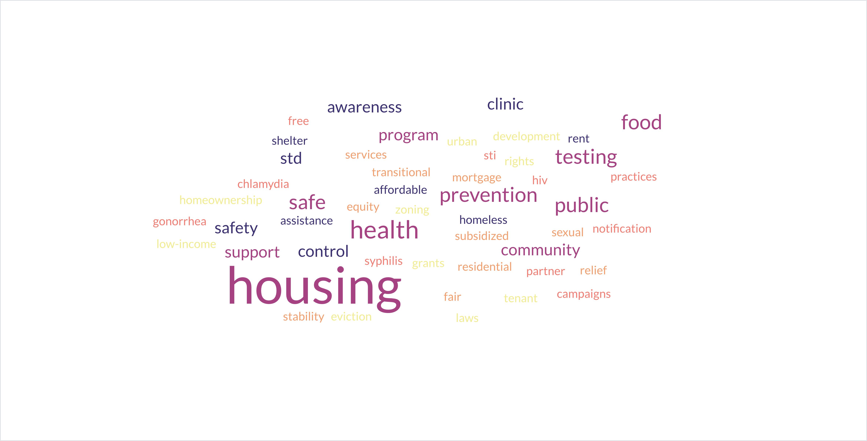
Insights and Visualization
EDA
Notes:
Why chart: Visual representation of text data where words are displayed in different sizes. It turns a bunch of comment text into a visual to show a snapshot of which programs have more positive comments

Slide 13
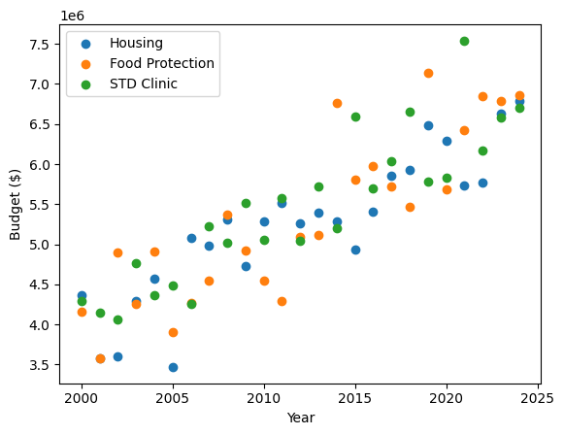
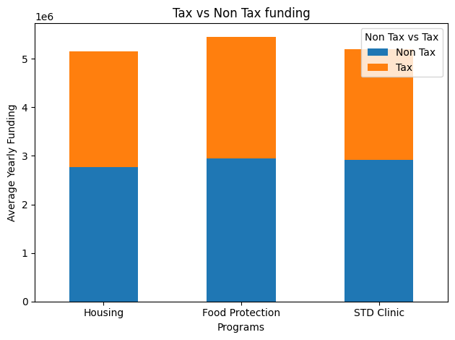
Insights and Visualization
Program budget by year
Average yearly funding sources for programs
Notes:
Budget by year for each program: It increases every year. We can expect that that there will be a steady increase every year.
Scatterplot: To show relationship between the year and the program.
Chart 2: We want to understand the funding mix for all programs. It is important to know because program that relies heavily on tax are at risk and we need to jknow how to proactively support them.
Stacked chart help[s compares tax vs non-tax across multiple categories of data

Slide 14
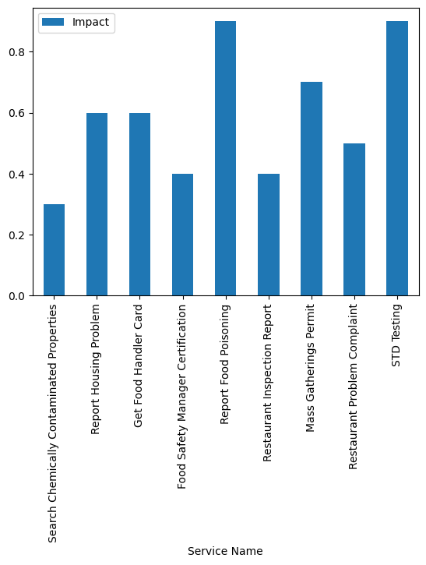
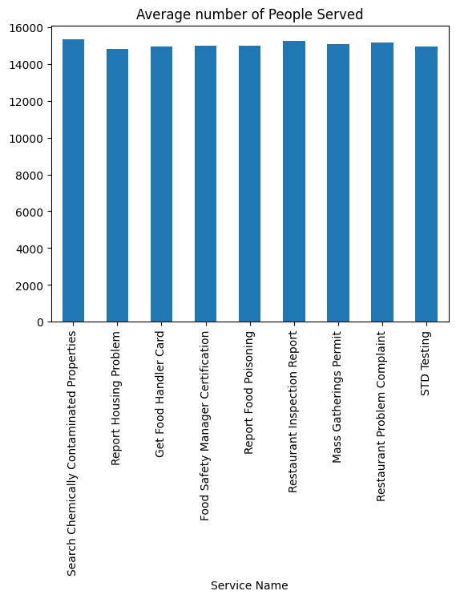
Insights and Visualization
Impact of Program
Average number of people served or utilization rtate
Notes:
Impact of program: It based on the weighted average of multiple external factors, including internal impact/value of program, avg ranking of customers, budget allocated and customer positive comments.
Bar chat helps to compare the numerical value of the impacts. Likewise utilization rate: The data shows that the people served or those who utilized the services. Even thought it is consistent among programs we can see that the impact of the program differs. This can help us allocate resources better. E.g. if we have two services in the same program and service A a has an impact of 30% but serves 1000 people and program B has an impact of 70% and serves 500 people. If we get the total utilization for program A, it will give u 300k utilization and 350k for program.

Slide 15
Insights and Visualization
Resource Allocation Outcome
 | Utilization | Tax Funding Allocation
Housing | $5M | 33%
Food Protection | $2M | 14% | $12M | Tax Amount
STD | $7M | 50%
Notes:
-

Slide 16
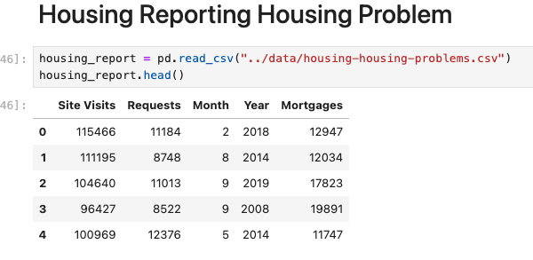
Insights and Visualization
Predictive Model
Coefficients | 1.8, 1.9, -8.5, 2.8
Intercept | 26550
Mean Squared Error | 1709640
Root mean Squared Error | 1307
Notes:
We used a statistical method called linear regression to predict the number of housing requests based on factors like site visits, month, year, and mortgages. Here's what we found: we are off by a +1k+. so if we predicted 12k it might be 1k more or less.

Slide 17
Recommendation and Decision Support Models
Use developed model for decision-support model
Setup a data warehouse/data lake
Build predictive model for each service to help predict utilization.

Slide 18
Recommendation and Decision Support Models
Use framework to allocate funds based on utilization.
Provide stakeholders with template tool. Train stakeholders on new data collection tool.
Implement model on one program, track KPIs and reiterate across multiple programs. Track metrics and continuously improve model.

Slide 19
Limitations –
Data Availability
Data Quality
Forecasting Assumptions
Predictive model Inaccuracy
Economic Factors/Tax cuts
Political Climate
Resistance to Change
Notes:
Models are not 100% accurate, so keep RMSE in mind. Customer sentiment sources should be diversified for a more accurate community and represenation.
Better data: Look for more data points and other factors that could be influencing the results. to increase
We need to do some forecasting of site visits and use to predict. We can use ARIMA if we hade more value.
We used multiple linear regression cos we had a handful of independent variable.
We could build a deep learning model if we tracked more independent variables.
For every service we build its own predicting model. To predict future community needs and multiply by the impact score and then we allocate resources based on that. Feature engineering: Refine the current data by transforming variables or creating new ones from the existing data. Regularization techniques: Use methods like Ridge or Lasso regression to handle overfitting and make the model more generalizable

Slide 20
Considerations – Stakeholder Buy-In
Lack of project awareness
Inability to provide data
Increased workload
Use of New tools

Slide 21
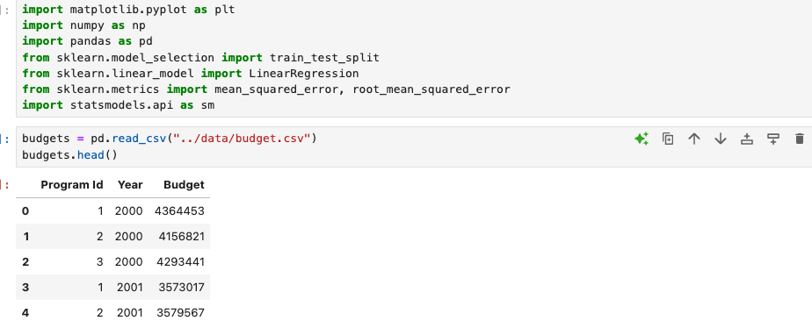
Technical Overview
Python Programming – Installing Packages

Slide 22
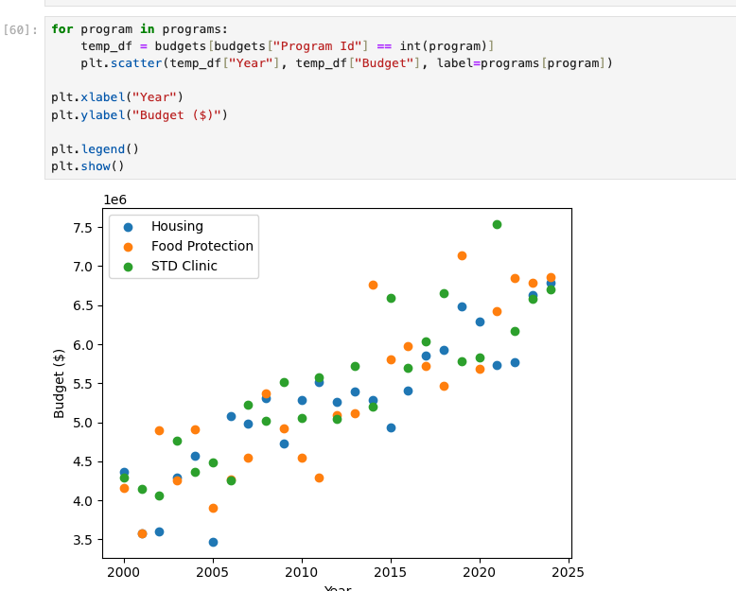
Technical Overview
Python Programming – Scatter plots
Program budget by year

Slide 23
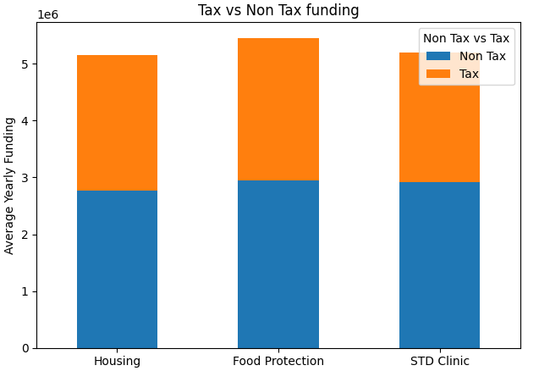
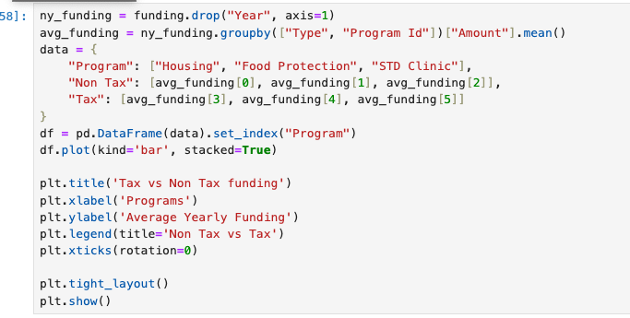
Technical Overview
Python Programming – Stacked bar chart
Average yearly funding sources for programs

Slide 24
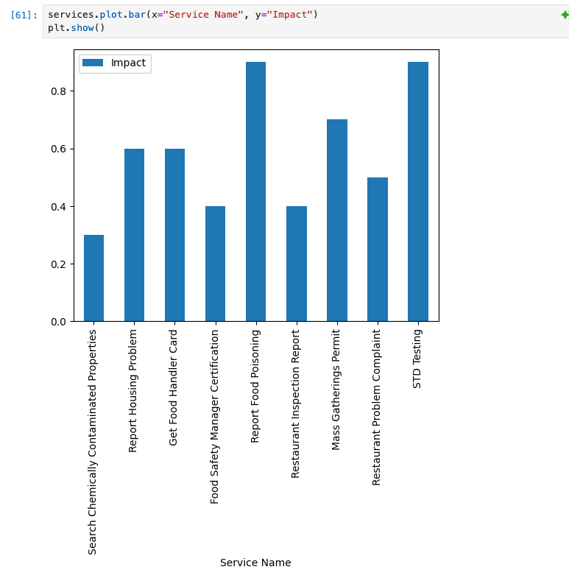
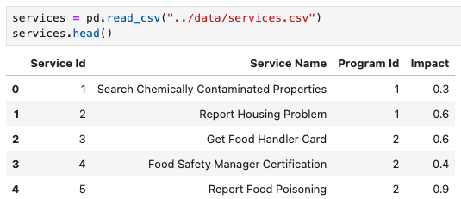
Technical Overview
Python Programming – Bar Chart
Impact of Program

Slide 25
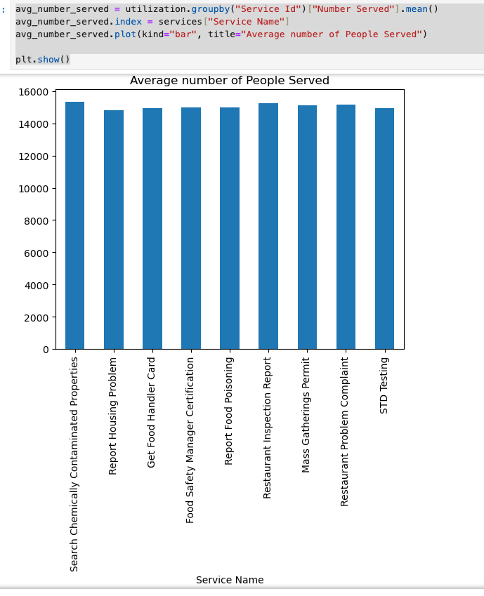
Technical Overview
Python Programming – Bar Chart
Average number of people served or utilization rate

Slide 26
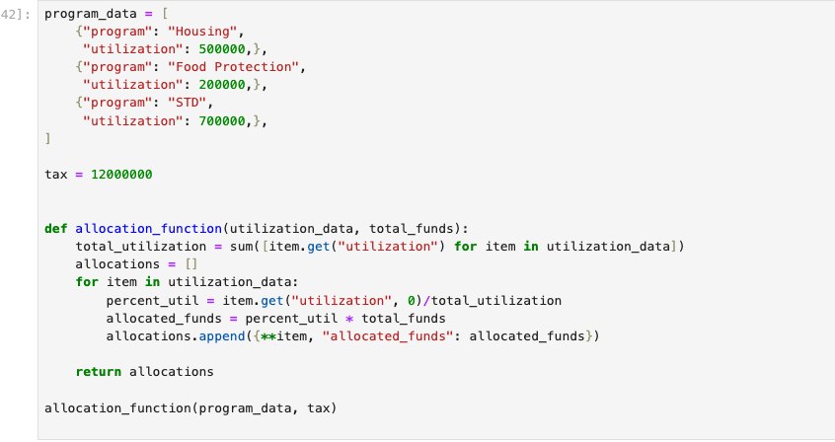
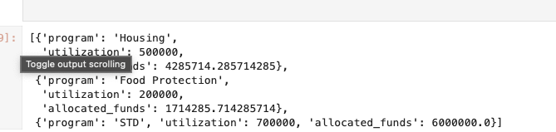
Technical Overview
Python Programming - Allocation Framework

Slide 27
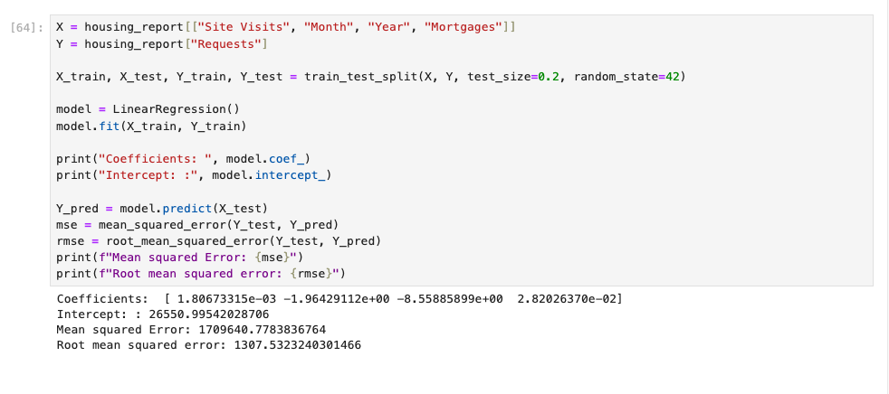
Technical Overview
Python Programming – Multivariate Regression Model

Slide 28
Conclusion
Identify underfunded programs
Ensure long-term sustainability
Maximize community impact
Optimally allocate funding resources

Slide 29
Next Step
Data Collection
Data Infrastructure

Slide 30
Thank
Thank
You
You !

Slide 31
Questions
Questions
?

